Slide 1
Network Design Peer Review

Slide 2
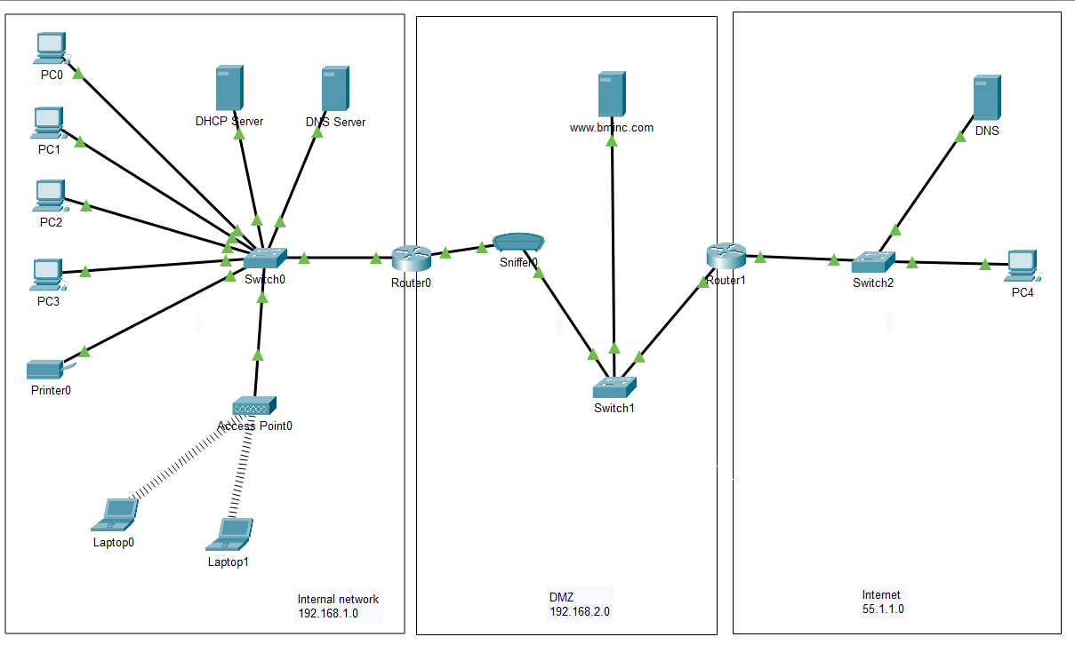
Network design
I decided to divide the network into an internal and a DMZ.
You can see the IP address for internal network, DMZ and Internet.
The public web server is www.bminc.com and it is hosted in the DMZ.

Slide 3
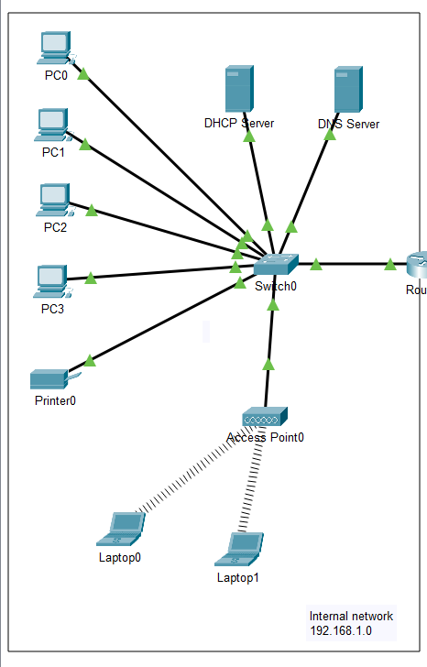
Internal network
The internal network has a its own DHCP server and DNS server.
The IP address for this networ is 192.168.1.0
There are 4 PCs for each imployee. These PCs have IP addresses provided by DHCP.
There is also an Access point to let the employees connect to the LAN by Laptops.
There is a printer with an static IP address that can be used by everyy user in the LAN.
All the devices connected to this LAN are able to ping to each other by IP address.

Slide 4
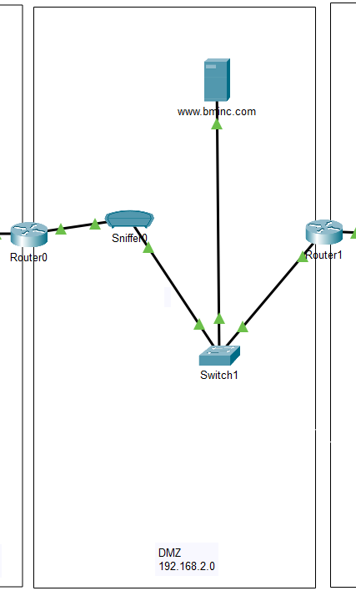
DMZ
The DMZ network hosts the public web server.
The IP address for this network is 192.168.2.0
There is a Packet Sniffer for security purposes.
This is a NAT router configuration.

Slide 5
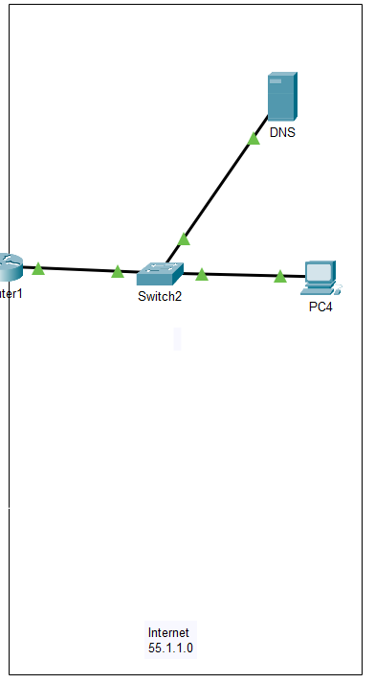
Internet
This is a simulation of the internet.
The IP address for this network is 55.1.1.0
It has its own DNS server.
There is an user that can acces to the public web server of the company.

Slide 6
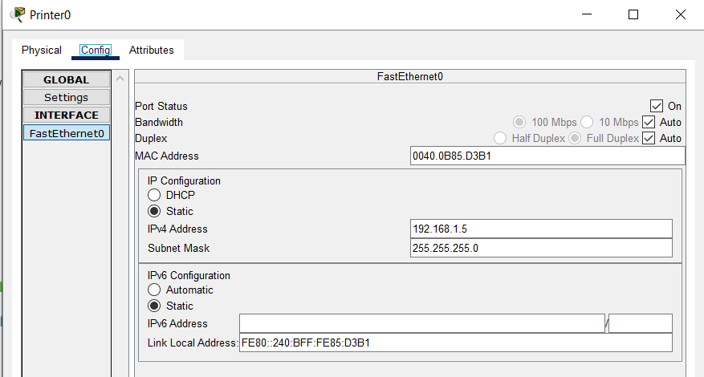
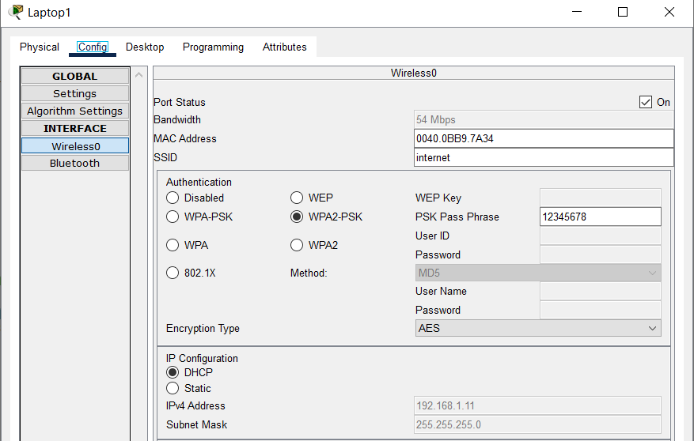
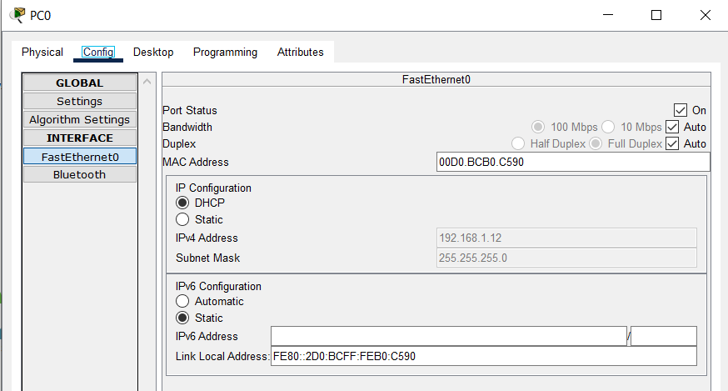
Network configurations

Slide 7
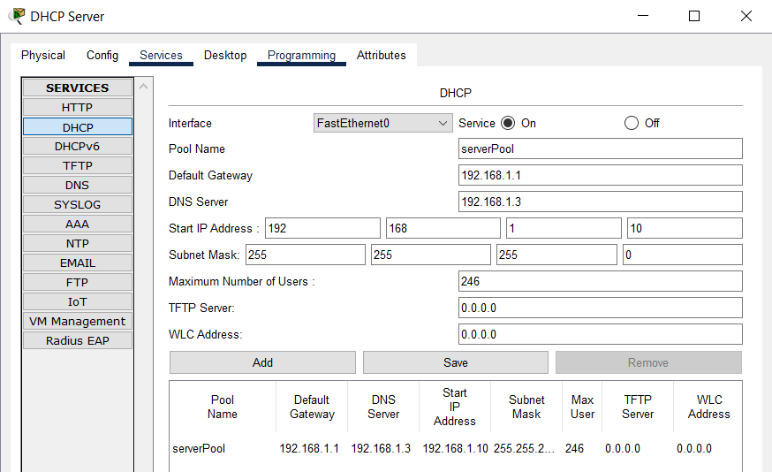
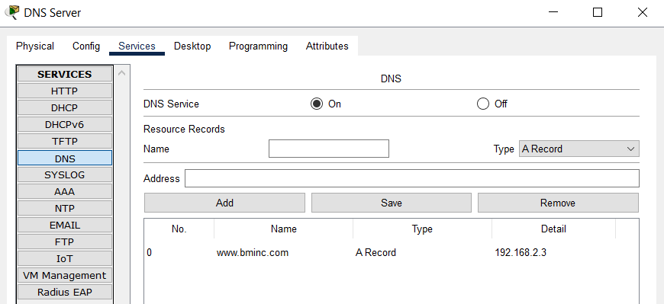
Network configurations

Slide 8
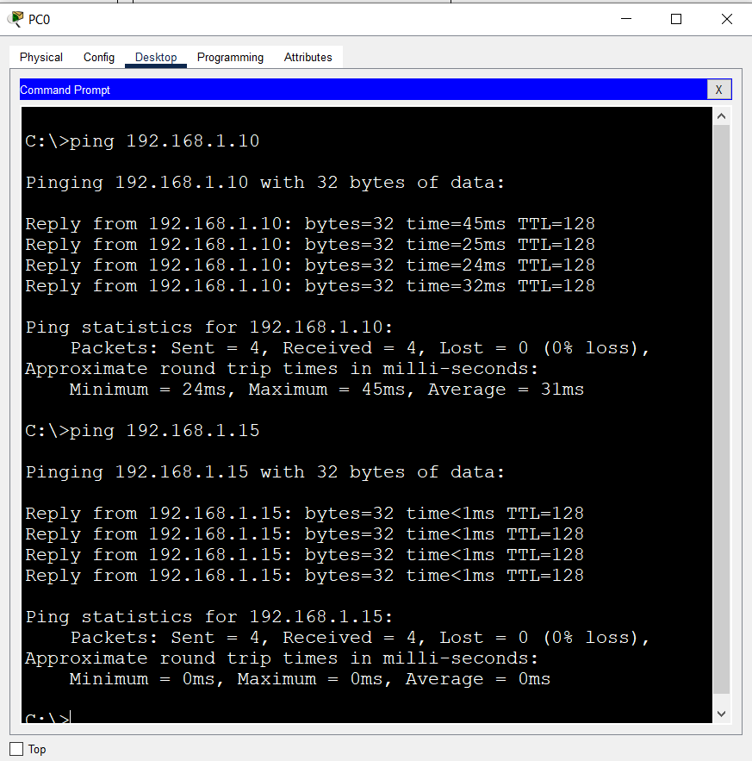
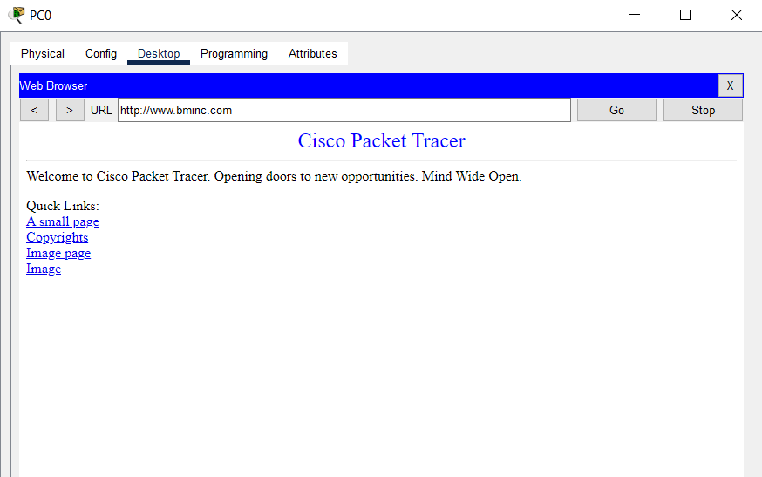
Tests
Connection between PC0 and Laptop0 and PC3
Accessing to www.bminc.com from PC 0

Slide 9
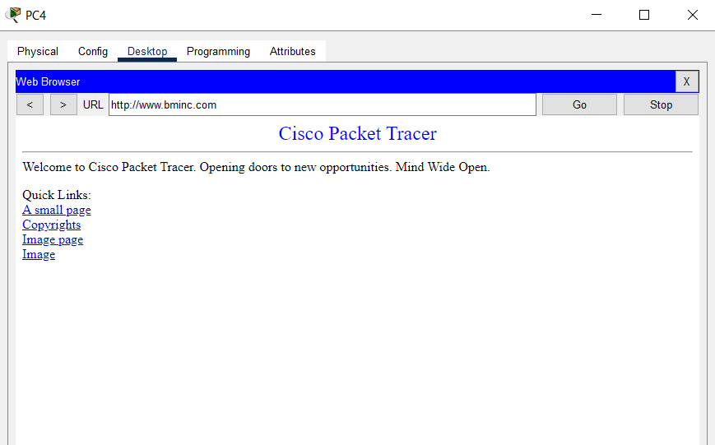
Tests
Accessing to www.bminc.com from PC 4 in the Internet network.

Slide 10
THANKS!

